Slide 1

The event will begin momentarily.
This event is being recorded
Captions are available by clicking the CC icon in the Zoom toolbar below
ASL is provided
For more information and to download presentation materials visit: www.access-board.gov/av

Slide 2



Inclusive Design of Autonomous Vehicles: A Public Dialogue
Accessibility for Passengers with Sensory and Cognitive Disabilities: Part 2
Continued discussion of ride hailing and on-board communication.

Slide 3
Agenda
Dr. Aaron Steinfeld, Carnegie Mellon University
Dr. Gregg Vanderheiden, University of Maryland, Trace Center
Darryl Cooper, Federal Communications Commission (FCC)
Ted Guild, World Wide Web Consortium (W3C)
Bruce Bailey, U.S. Access Board
Q&A and Open Dialogue
PowerPoint slides are available for download from:
www.access-board.gov/av

Slide 4
How to Participate
Ask Questions to Presenters
Submit questions using Zoom’s Q & A feature throughout the event
Ex. “Question – What are wheelchairs?“
Ex. “Question for the first presenter – Did your study look at scooters?”
Moderator will paraphrase question to presenters
We may not get to all questions
As an alternative, you may submit questions via email: events@access-board.gov
Contribute to the Open Discussion Today
Request to speak using Zoom’s Q & A feature
Ex. “Microphone – I’m Beth from XYZ Company and would like to talk about automated doors”
Ex. “Microphone – I’m Alex and I’d like to share my experience using an AV”
Host will unmute you (in Zoom), but please check your microphone
Moderator will call on you by name to speak
ASL – If you wish to be visible for signing, please put that in your request
Continue the Online Dialogue
http://transportationinnovation.ideascale.com
For assistance, email: ePolicyWorks@dol.gov

Slide 5

Dr. Aaron Steinfeld
Carnegie Mellon University
TBD Lab

Slide 6
Communication Accessibility in Hailing and Interacting with Autonomous Vehicles
Aaron Steinfeld, et al
Transportation Bots & Disabilities (TBD) Lab
Robotics Institute
Carnegie Mellon University

Slide 7
Many Pieces of the Puzzle
NIDILRR
DRRP on Robotics and Automation for Inclusive Transportation
RERC on Accessible Public Transportation
US DOT
Projects from the ATTRI Program
NSF National Robotics Initiative
NRI: FND: Mutually Aware Social Navigation
NRI: FND: Human-Robot Collaboration with Distributed and Embodied Intelligence
Additional insights drawn from ONR and NASA projects

Slide 8
Requesting Service
Leverage existing knowledge on making apps, websites, and touchscreens accessible (other talks in this series)
Users often need help discovering service options
Unfamiliar transportation mode options and capabilities
Hidden features
Conversational agents still need key advances
“Please be here 15 minutes before 5.”
“Will my bus reach the station in time for my train?”
(also, Christian Vogler’s comments in last session)

Slide 9
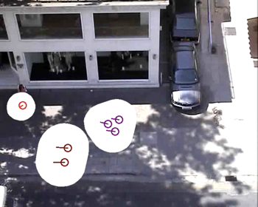
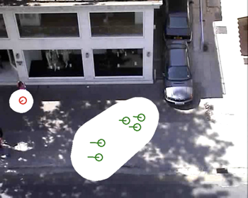
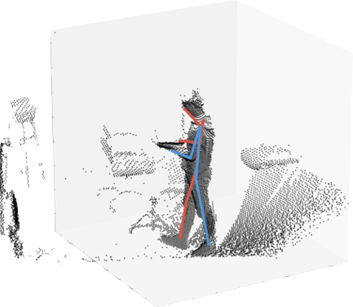
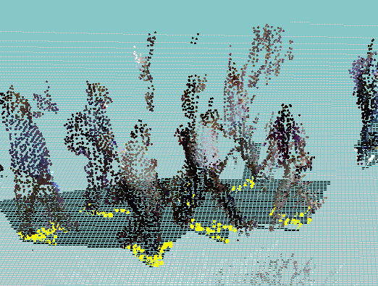
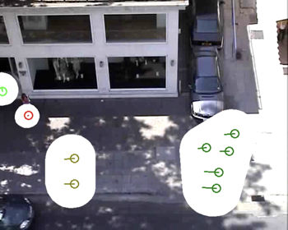
Navigating to/from the Curb
Moving through transportation hubs to the correct curb location
Move through and around crowds
Vehicle pickup/drop-off spots

Slide 10
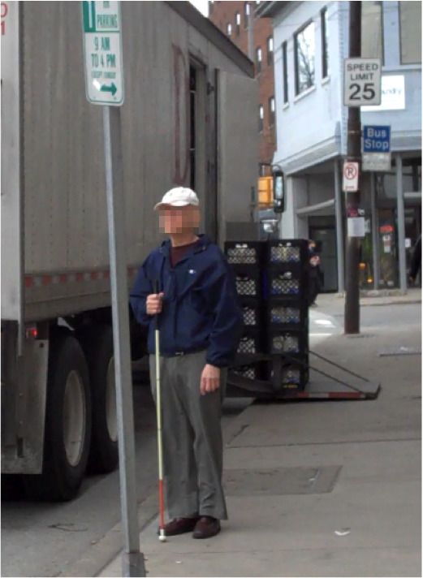
Rendezvous
Audible signals identify the user as having a disability
(Anil Lewis in last session)
Visual signals not always effective
Dense curbs
Users who cannot see them due to abilities or obstructions
Currently looking at using smartphones and vehicle sensors together to close the gap

Slide 11
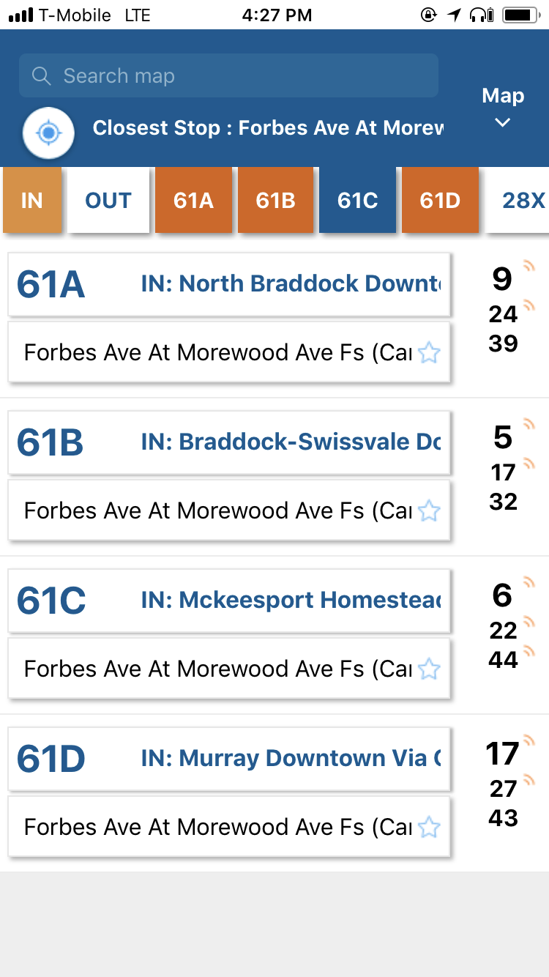
Artificial Intelligence Assistance
Learn user preferences
Macro level: interaction preferences
Micro level: commonly used destinations and services
Are these preferences shared with third-party systems?
Privacy
Data retention

Slide 12


Additional Lessons from Robotics
Human trust in autonomy
Inertia
Trust calibration
Self-assess performance and communicate to users and bystanders
AI assistants
AI jumps into the car
Speech in public settings
Disclosure of status

Slide 13







Aaron Steinfeld, steinfeld@cmu.edu
Grants from the National Science Foundation (National Robotics Initiative, IIS-1317989, IIS-1012733, IIS-0905148, IIS-0905228, IIS-1734361, & SES-1734456)
A grant from the Office of Naval Research (ONR N00014-18-1-2503).
The RERC-APT is funded by the National Institute on Disability, Independent Living, and Rehabilitation Research (NIDILRR grant numbers 90RE5011-01-00 and 90REGE0007; NIDRR grants H133E080019 and H133E130004). Additional funding was received from grants 90DPGE0003 and 90DP0061. NIDILRR is a Center within the Administration for Community Living, Department of Health and Human Services.
Support from the US DOT through the T-SET University Transportation Center, Mobility21 University Transportation Center, and the Accessible Transportation Technologies Research Initiative (ATTRI) program.
A grant from the National Aeronautics and Space Administration (80NSSC19K1133).
Other lab support from Disney Research Pittsburgh, IBM, and Traffic21 at Carnegie Mellon University, a program developed with the support of the Hillman Foundation.

Slide 14
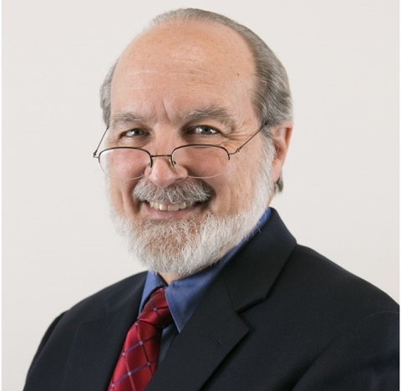
Dr. Gregg Vanderheiden
University of Maryland
Trace Center

Slide 15

Cognitive Access to Autonomous Vehicles
Gregg Vanderheiden Ph.D.
Trace R&D Center
University of Maryland, College Park

Slide 16
Goal of the presentation
To highlight some of the many things that need to be considered when designing autonomous vehicles for use by people with cognitive disabilities
Much more complicated than first appears
But if / when we can crack the problems - it will be a great advance for these user groups

Slide 17
Cognitive Disabilities do not occur in a vacuum.
Often the person will have other disabilities as well
Physical
Vision (low vision, blindness)
Hearing (Hard of hearing or Aphasia)
Deaf and only speak sign language
Speech disability (non-vocal, dysarthria, aphasia, stutter/stammer,…)
For these individuals, many of the ‘general’ solutions won’t work
Speech interfaces (requires speech)
Select from displayed destinations (requires reach and vision)
They insert (or touch with) something (requires reach and manipulation)
Need to have a spectrum of interface solutions
So that something is available that is within abilities of each person

Slide 18
Problems occur en-route
People may change mind en-route
Changing trip is cognitively more complicated / complex than just going somewhere
People may panic en-route
Maybe something happens / changes
May be spontaneous panic
Best solution to en-route problems - will most likely involve people
Someone from ride service always available a button press
Including signers
With access to information about person ?
Someone very familiar to person, is always ‘on call’
Perhaps invoke “user’s on-call person” BEFORE release of info on person.

Slide 19
Interface issues / design spaces
The Designs & interface options need to cover travelers who:
may have no memory
may be easily confused
may have no ability to give clear instructions
may speak with words or phrases that are only meaningful to themselves
may have no speech – or have foreign or deaf accent that can’t be handled
may not speak English
may (only) use sign language (can vehicle understand sign language? )
may not be able to “see” that the car has arrived – or assist vehicle in finding the passenger
may not be familiar with or be able to use “apps” at all
may be hard of hearing and need direct-coupling to audio to hear over noise
may be mixed (multiple people with different needs and abilities)

Slide 20
Interface strategies / options
Ultra simple interface - No need for instructions for anyone - obvious
Layered interface - Very simple, limited interface, with more options (complexity) layered behind
Not require reading - Verbal (vocal or visual) or Non-verbal (pictures, illustrations, maps ) (see also tags)
Work with signer language users - Everything presented in voice, text, and sign Sign language interpreters for the vehicle on call to allow two-way communication
Use Cue and respond - Question and answer. Options presented until response.
Provide (silence-able or optional) description of features (like bell hop) when you enter vehicle
(someday) provide a full-natural-language, sufficiently-intelligent, artificial “driver”
A feature for AV that points out passenger in crowded or confusing location so it can get close - Visual, auditory, tactile. Directional or ‘increasing as you get closer”
A feature for passenger to guide them to vehicle – especially if many cars arrive at a location. Phone version of this feature for those who can’t use “apps
An interaction TIPS feature – for AV “live assistants” interacting with a person with their particular disability for 1st time
A trained-human-in-the-loop option – that is instantly invokable in problem situations
Trip Tags

Slide 21
Trip Tags
Vehicle takes instructions from a Tag
Tag presented by traveler - or person sending
Physical token - or Electronic Device (e.g. phone)
Possible tag instructions (in addition to destination) might include
Option – Automatically send progress texts to sender or destination
Option – Traveler not able to change destination after starting
Option – Traveler is tagged as protected passenger
Option – Visual/auditory monitoring en-route (of passenger - of surrounds)
Option – Doors locked until tagged with special tag at destination.
(variation on package deliver – but with extra considerations)
Tricky – need secure overrides (Central?, Sender? First responder? In emergency?)
Tricky to implement
The vehicle is delivering people – not packages
ABUSE POTENTIAL here as well
(e.g. You get in and someone walks up and tags you to a location with doors locked and you locked out – kidnapping you.)

Slide 22
Huge privacy and data abuse potential
Any data collected about users with special accommodations – can be used in many ways to the detriment of the traveler
Used to discriminate
Employment
Housing
Travel
Anyone wanting to avoid risk
Used to target them
Easier to confuse – deceive (e.g. for selling things to them)
Easier to attack
and more…
Solution?
Really tough issue
Perhaps – all data and us of data on user’s abilities is overseen by external Privacy and Data Ethics Council.

Slide 23

Thank You
This work was funded in part by grant #90REGE0008 from the National Institute on Disability, Independent Living, and Rehabilitation Research (NIDILRR) of the Administration for Community Living (ACL), Dept of Health and Human Services (HHS)

Slide 24

Darryl Cooper
FCC Disability Rights Office

Slide 25

Inclusive Design of Autonomous Vehicles Passengers with Sensory and Cognitive Disabilities
Darryl Cooper, Attorney Advisor, Disability Rights Office

Slide 26
What Are Communications?
Hallmarks of Communications
Two-Way Interactions
In Real or Near Real-Time
Between Two or More People
Telecommunications Services and Equipment
Wireline and Wireless Phone Service and Handsets
Includes Voice over Internet Protocol
Advanced Communications Services and Equipment
Non-Interconnected VoIP
Email and Text Messaging
Internet Browsing

Slide 27
In-Car Entertainment
Closed Captioning for Video Programming
Audio Description
Emergency Information
User Interfaces, Devices, and Program Guides

Slide 28
FCC Accessibility Resources
Subscribe to AccessInfo@fcc.gov
Visit FCC Disability Rights Office webpage: www.fcc.gov/accessibility
DRO@fcc.gov, 844-432-2275 (videophone), 202-418-2517 (voice)

Slide 29

Ted Guild
World Wide Web Consortium (W3C)

Slide 30
Carmunication background
Accessible Transportation
W3C Web Accessibility Initiative, Automotive, Transportation and related activities April 2021

Slide 31

What is W3C?
World Wide Web Consortium
Standards body for the Web
Founded by inventor of Web
Tim Berners-Lee
Hosts: MIT, Beihang, Keio, ERCIM
~450 members

Slide 32
W3C Web Accessibility Initiative (WAI)
W3C as a helpful locus of accessibility expertise providing:
Normative Specs, e.g. ARIA, WCAG
Best Practices & Informative Notes
Accessible Platform Architectures (APA) WG
APA's mandate includes emerging technologies

Slide 33
Related works
Automotive Working Group
Linked Building Data Community Group
Linked Data for Accessibility Community Group
Cross Standards Development Organization coordination on transportation ontologies

Slide 34
Accessibility and Travel experiences
Relayed ride hailing experiences as well as other modes of travel
Ted’s cab sharing story that indirectly led to him joining W3C
Hurricane Floyd, September 1999 left up to 13 inches (325 mm) of rain, wind gusts of up to 60 mph (95 km/h) affecting NYC

Slide 35
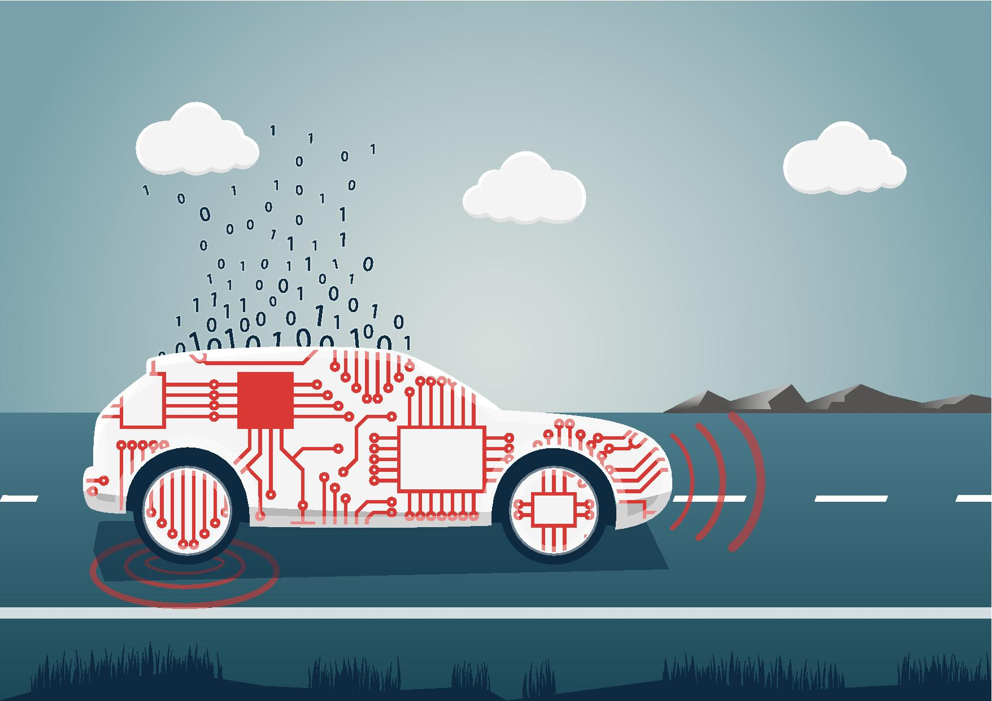
Transportation sector technical advances as an enabler
Excitement around autonomous vehicles
Importance of individuals’ autonomy (independence)

Slide 36
Factoring in Accessibility into Data model design
Profiles and individual needs, conveying to vehicle operators, rental and ride-share companies etc
Vehicle capabilities
Geospatial data considerations – granular location, building drop-off/pickup considerations
“Intelligent Transportation Systems” would look rather stupid sending a [fill in the blank]
Remapping of signals in vehicle to alternate controls or paired devices

Slide 37
Why introduce this topic now?
Easier and cheaper to do up front than an afterthought
Technologists generally like to do the right thing and improve lives
Encourage you to make argument to management for including this in your designs
Avoid costly litigation from lack of conformance to ADA, draw comparison to GDPR
Marketshare not negligible – Estimated 15% of Americans have some form of accessibility concerns
Good and bad examples – only name the good (e.g., Apple iPhone)

Slide 38
Question and follow up
www.w3.org/wai
www.w3.org/auto

Slide 39
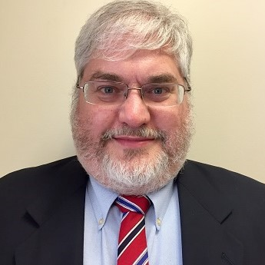
Bruce Bailey
U.S. Access Board

Slide 40
E103.4 Defined Terms “ICT” and “IT”
ICT – (Information and Communication Technology)
Information technology and other equipment, systems, technologies, or processes, for which the principal function is the creation, manipulation, storage, display, receipt, or transmission of electronic data and information, as well as any associated content.
Examples of ICT include, but are not limited to: computers and peripheral equipment; information kiosks and transaction machines; telecommunications equipment; customer premises equipment; multifunction office machines; software; applications; Web sites; videos; and, electronic documents.
IT (Information Technology) – same meaning as 40 U.S.C. 11101(6)

Slide 41
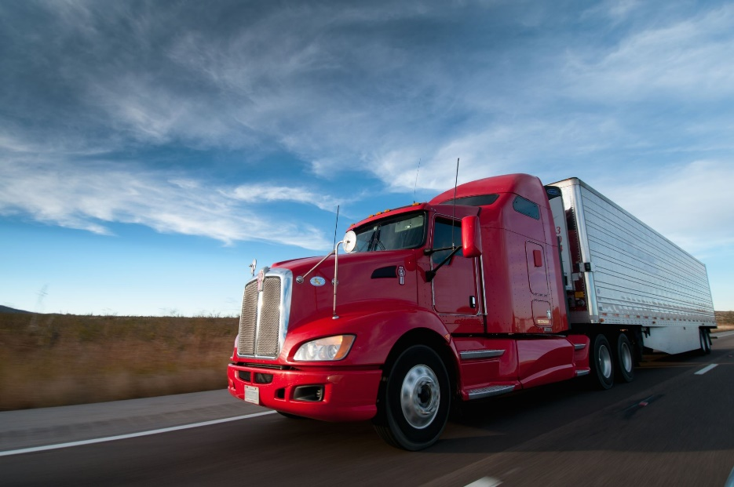
Covered by 508?
Truck – Not ICT
Principal function is not the creation, manipulation, storage, display, receipt, or transmission of electronic data and information.

Slide 42
“Clinger-Cohen Act of 1996” 40 U.S.C. 11101(6)
(6) Information technology. — The term “information technology” —
with respect to an executive agency means any equipment or interconnected system or subsystem of equipment, used in the automatic acquisition, storage, analysis, evaluation, manipulation, management, movement, control, display, switching, interchange, transmission, or reception of data or information by the executive agency, if the equipment is used by the executive agency directly or is used by a contractor under a contract with the executive agency that requires the use —
of that equipment; or
of that equipment to a significant extent in the performance of a service or the furnishing of a product;
includes computers, ancillary equipment (including imaging peripherals, input, output, and storage devices necessary for security and surveillance), peripheral equipment designed to be controlled by the central processing unit of a computer, software, firmware and similar procedures, services (including support services), and related resources; but
does not include any equipment acquired by a federal contractor incidental to a federal contract.

Slide 43
508 Standards and Autonomous Vehicles
Consider modern vehicle dashboard and action verbs from CC IT definition:
… used in the automatic acquisition, storage, analysis, evaluation, manipulation, management, movement, control, display, switching, interchange, transmission, or reception of data or information
Vehicle dashboard is not a “principal function” relative to the function of driving.
But what if no person is driving?

Slide 44

Open Discussion
Request to share information, ideas, or comments using Zoom’s Q & A feature:
Microphone – You will be allowed to speak
Question – You will not speak (moderator will read your question)
Name (and organization)
Brief description of content
Host will enter you into queue
Moderator will announce when it is your turn to talk
Host will unmute you in the Zoom platform
You may need to unmute locally (*6 by phone)
Moderator will also announce next in queue
Presenters may respond to some comments
Alternative: events@access-board.gov
ASL – note in request to comment
Limit your comments to less than two minutes

Slide 45
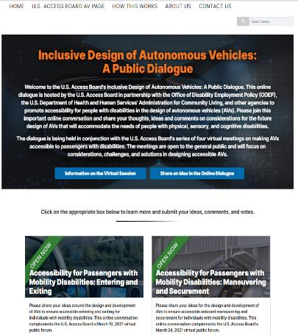
Online Dialogue
Continue the conversation Online
http://transportationinnovation.ideascale.com
Share ideas, comment, vote
For assistance, email: ePolicyWorks@dol.gov

Slide 46
Thank you for attending today's session.

